Slide 1
WELCOME TO MS POWERPOINT

Slide 2
INTRODUCTION
Easy to use and accessible
Efficient information organization
Time saving and convenience

Slide 3

OUR TEAM

Slide 4
PROBLEM SOLVING
Step 1
Find the problem
Step 2
Think about the solution
Step 3
Build a prototype of your idea

Slide 5
RESOURCES
Visit Microsoft

Slide 6
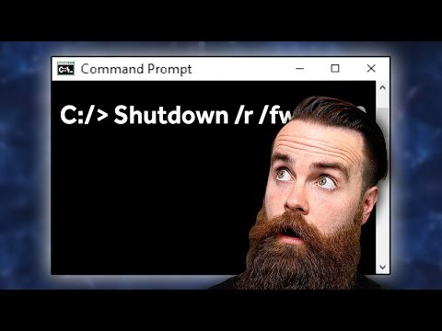
VIDEO

